Slide 1
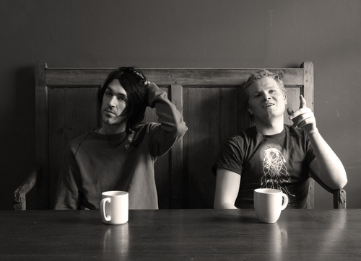
Duologues & sCENES
Drama
Year 9
Lesson 2 Proxemics

Slide 2
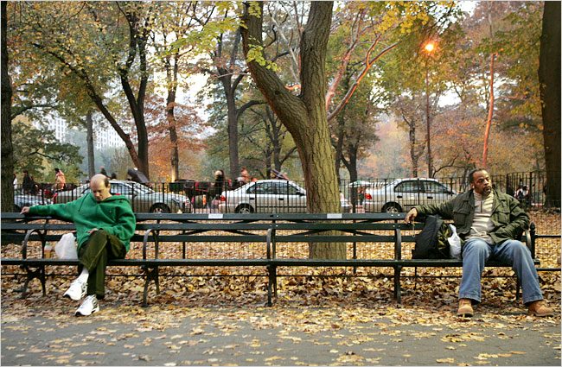
LESSON AIM
To investigate the use of Proxemics within a scene.

Slide 3
LESSON OUTCOME
LEVEL 4 – All students will know what PROXEMICS means.
LEVEL 5 – Students will understand how to use PROXEMICS in a scene.
LEVEL 6 – Students will be able to understand and describe PROXEMICS and use it appropriately within a scene.
LEVEL 7 - Students will be able to understand and explain PROXEMICS in detail and use it effectively within a scene.

Slide 4
WHAT IS PROXEMICS?
Proxemics - Reading the meaning of space, levels and distance in a performance. It is to understand the relationships within the space.

Slide 5
GREETINGS
Walk around the space...
Spot someone far away and wave...
Spot someone far away and wave and shout Hi...
Walk around the space...
When you meet someone stop and gesture ‘hello’ with your face only.
When you meet someone stop and shake hands and say ‘hello’
When you meet someone stop and touch knees and say ‘hello’
When you meet someone stop and touch bottoms and say ‘hello’
When you meet someone stop and hug and say ‘hello’

Slide 6
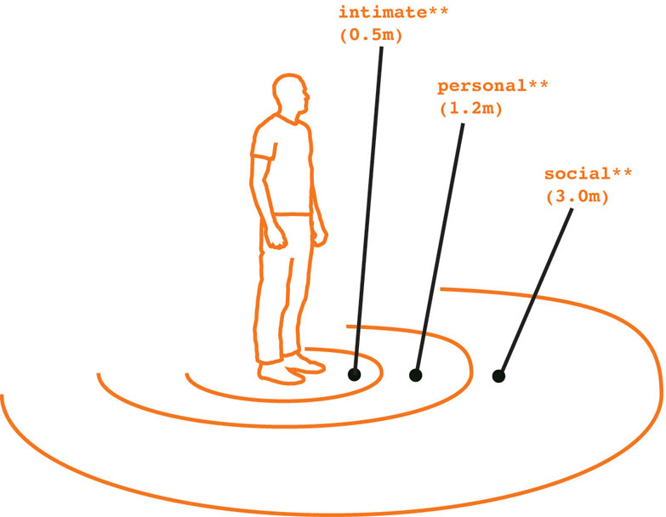
WHAT SPACE DID WE USE?

Slide 7
BREAKFAST CEREAL
Get into pairs.
Label yourselves ‘A’ and ‘B’
Each student must take a piece of paper from the teacher.
Stand opposite each other and recall the lines.
Try to learn the lines.
Create a small short scene which uses the exact words, you MUST NOT CHANGE THE WORDS or USE ANY OTHER WORDS

Slide 8
BREAKFAST CEREAL
A: Good Morning.
B: Morning.
A: Please pass me the milk.
B: I’m afraid we’ve run out.
A: Has the paper come?
B: It’s right in front of you.

Slide 9
SCENARIO CARDS
Each pair will be given a Scenario Card.
You may choose an easy, medium or hard scenario.
You have 3 minutes to improvise a new scenario – but you must find a way to use the exact lines from the breakfast scene. Put as much activity into the scene as you can.
THERE CAN BE SECTIONS OF THE SCENE WHERE NO TALKING TAKES PLACE.
TRY TO MAKE SENSE OF EVERY WORD IN YOUR SCRIPT – EVEN IF IT DOESN’T MAKE SENSE AT FIRST
SIMPLE TESTING TRICKY TRICKY

Slide 10


Slide 11
PROXEMICS CARDS
Each pair will be given a Proxemics Card with an instruction you must incorporate into your scene.
You have 5 minutes to improvise a new scenario – but you must find a way to use the exact lines from the breakfast scene and incorporate your new instructions. Put as much activity into the scene as you can.
THERE CAN BE SECTIONS OF THE SCENE WHERE NO TALKING TAKES PLACE.
TRY TO MAKE SENSE OF EVERY WORD IN YOUR SCRIPT – EVEN IF IT DOESN’T MAKE SENSE AT FIRST
SIMPLE TESTING TRICKY TRICKY

Slide 12
Each pair is to join another pair and then perform their pieces to each other.
Once you have performed see if you can work out what their Proxemics card instructed them to do .
Did it work for the scene? Did it fit with the scenario? If so why?

Slide 13
APPROPRIATE PROXEMICS
Create your own scene using Proxemics appropriate to the scene. You may use the Breakfast Cereal lines or create your own. Ensure you make decisions about, space, distance and levels which are appropriate to the scene. You have 5 minutes.

Slide 15
QUIZ QUIZ TRADE
QUIZ Ask your partner a question, let them answer, if incorrect tell them the correct answer.
QUIZ Swap over and repeat the exercise, so you have both asked each other a question.
TRADE questions with your partner and then go and find a new partner to work with and repeat the QUIZ, QUIZ, TRADE.

Slide 16
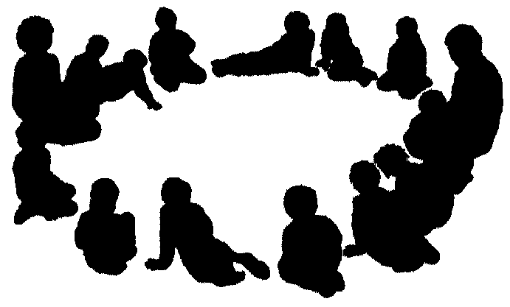
CIRCLE TIME
Notes:
Use this time to allow students to share their ideas and feedback to the rest of the class.

Slide 17
What did you achieve today? LESSON OUTCOME
LEVEL 4 – All students will know what PROXEMICS means.
LEVEL 5 – Students will understand how to use PROXEMICS in a scene.
LEVEL 6 – Students will be able to understand and describe PROXEMICS and use it appropriately within a scene.
LEVEL 7 - Students will be able to understand and explain PROXEMICS in detail and use it effectively within a scene.

Slide 18
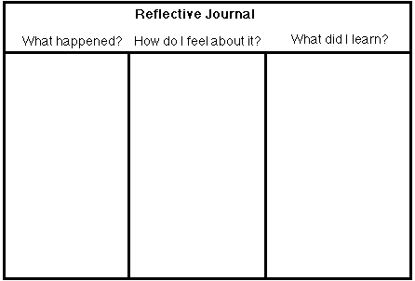
REFLECTIVE LOG
It is important to reflect on every lesson and begin thinking about setting targets for yourselves. For assessment it is important to keep a log book of activities, so you must write a reflective log for each lesson.

